Slide 1
DevSecOps
Training

Slide 2
Agenda
https://docs.google.com/document/d/1Cydl3Eelcl1fEn4Epo7Ww7MBHmeIU3oC/edit

Slide 3
Training Format
Concepts
Hands-on exercises
Assignments
Interactive

Slide 4
Timing
Start time at 10 am
Break 11.30 am
Lunch 1pm to 2pm
Break 3.40
End at 6 pm

Slide 5
WHY DEVSECOPS MATTERS
Modern applications run critical business operations
Banking applications handle highly sensitive data
Security failures cause financial and reputational damage
Regulatory requirements are increasing
Late security fixes are expensive
Speed without security increases risk
DevSecOps balances agility and security

Slide 6
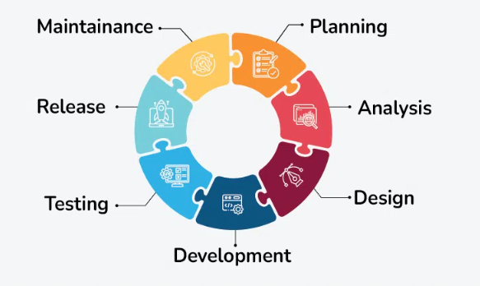
TRADITIONAL SDLC

Slide 7
TRADITIONAL SDLC
Security happens at the end
Testing is mostly manual
Issues found late in the lifecycle
High cost of remediation
Limited collaboration between teams
Slow feedback loops

Slide 8
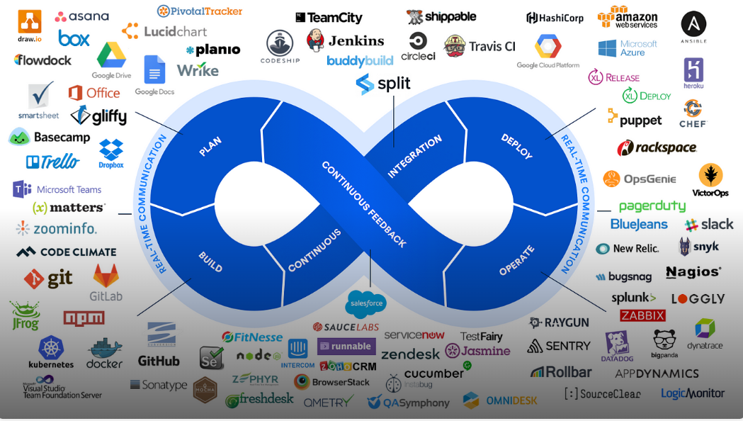
WHAT IS DEVOPS

Slide 9
WHAT IS DEVOPS
Focus on speed and automation
Continuous integration and delivery
Improved collaboration between Dev and Ops
Infrastructure as code
Faster releases
Reduced operational friction

Slide 10
LIMITATIONS OF DEVOPS
Security treated as a separate phase
Security teams become bottlenecks
Reactive vulnerability handling
Compliance handled late
Increased risk exposure

Slide 11
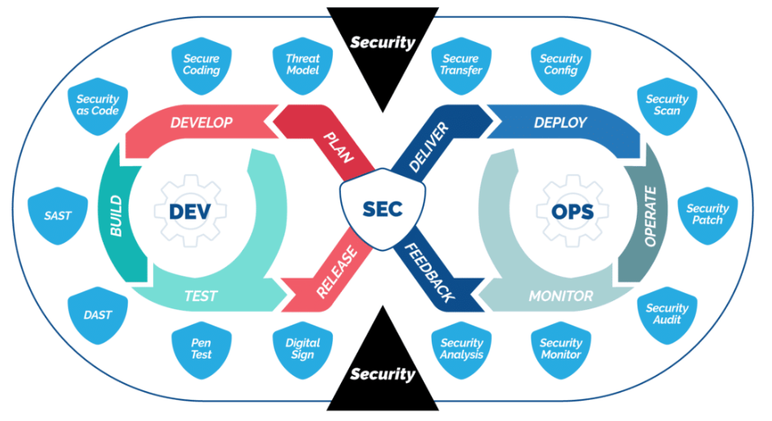
WHAT IS DEVSECOPS

Slide 12
WHAT IS DEVSECOPS
Security integrated into DevOps
Security as shared responsibility
Automation of security controls
Security built into pipelines
Continuous security feedback
Secure by design mindset

Slide 13
DEVOPS VS DEVSECOPS
DevOps focuses on speed and reliability
DevSecOps focuses on speed, reliability, and security
Security shifts from gatekeeper to enabler
Automation replaces manual security checks
Risk is managed continuously

Slide 14
CORE DEVSECOPS PRINCIPLES
Shared responsibility for security
Shift security left
Automate security testing
Secure by design
Least privilege access
Continuous monitoring
Continuous improvement

Slide 15
DEVSECOPS CULTURE
Collaboration over silos
Security is everyone’s responsibility
Blameless culture
Fast feedback to developers
Learning from incidents
Security as a quality attribute

Slide 16
DEVSECOPS IN BANKING
High regulatory expectations
Strict data protection requirements
Audit and traceability needed
Fraud prevention critical
Customer trust is paramount
Security incidents have high impact

Slide 17
WHAT CHANGES FOR ENGINEERS
Security requirements from day one
Secure coding practices
Security tools in daily workflow
Understanding compliance impact
Thinking like an attacker
Ownership of security outcomes

Slide 18
Infra setup
Ubuntu VM
Azure account
VM Access
VS Code
Docker
DevSecOps tools

Slide 19
SECURE SDLC OVERVIEW
Security embedded in every phase
Predictable and repeatable security
Early risk identification
Reduced remediation cost
Improved compliance posture
Supports DevSecOps automation

Slide 20
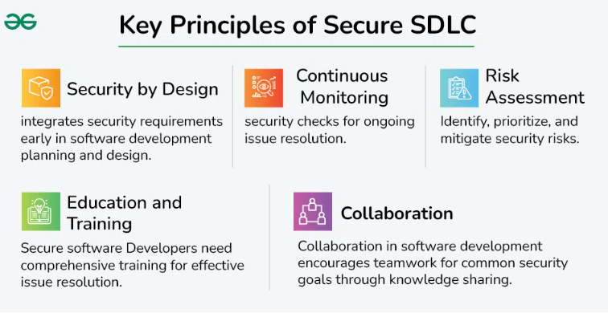
SECURE SDLC OVERVIEW

Slide 21
SECURE SDLC PHASES
Requirements
Design
Development
Build
Test
Deploy
Operate

Slide 22
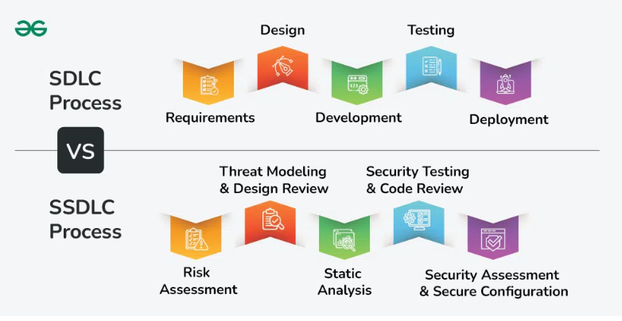
SECURE SDLC PHASES

Slide 23
REQUIREMENTS PHASE SECURITY
Identify sensitive data
Regulatory requirements
Security and privacy requirements
Threat assumptions
Audit requirements
Risk classification

Slide 24
DESIGN PHASE SECURITY
Threat modeling
Secure architecture patterns
Trust boundaries
Authentication design
Authorization design
Data flow security

Slide 25
DEVELOPMENT PHASE SECURITY
Secure coding practices
Input validation
Error handling
Avoid hardcoded secrets
Use approved libraries
Peer code reviews

Slide 26
BUILD PHASE SECURITY
Static application security testing
Dependency scanning
Secret detection
Secure build pipelines
Artifact integrity
Version control security

Slide 27
TEST PHASE SECURITY
Dynamic application security testing
API security testing
Business logic testing
Negative testing
Automated security tests
Manual exploratory testing

Slide 28
DEPLOY & OPERATE SECURITY
Secure configurations
Secrets management
Monitoring and alerting
Logging and audit trails
Incident response readiness
Patch management

Slide 29
SHIFT LEFT AND SHIFT RIGHT
Security early in development
Security feedback from production
Continuous improvement
Learning from incidents
Security metrics
Closing feedback loops

Slide 30
SECURE SDLC AND COMPLIANCE
Compliance starts at requirements
Controls embedded in design
Evidence generated automatically
Audit readiness
Reduced compliance friction
Continuous compliance

Slide 31
What is Threat Modeling?
Proactive security design activity
Identify threats before coding
Focuses on attacker mindset
Reduces costly rework later
Key part of Secure SDLC

Slide 32
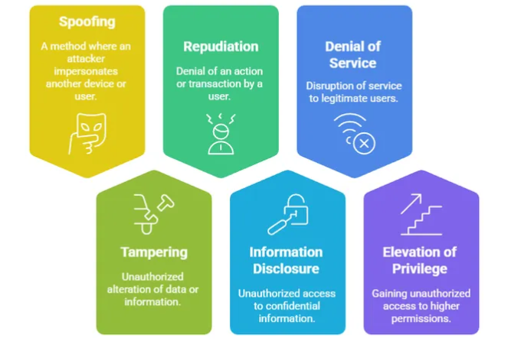
What is STRIDE?

Slide 33
What is STRIDE?
Threat modeling framework by Microsoft
Categorises common threat types
Used during design phase
Easy to remember and apply
Maps well to application risks

Slide 34
STRIDE Categories
S – Spoofing identity
T – Tampering with data
R – Repudiation
I – Information disclosure
D – Denial of service
E – Elevation of privilege

Slide 35
STRIDE – Spoofing & Tampering
Spoofing: Pretending to be another user
Examples: Credential theft, session hijacking
Tampering: Unauthorized data modification
Examples: API payload manipulation
Controls: Authentication, integrity checks

Slide 36
STRIDE – Repudiation & Information Disclosure
Repudiation: Actions cannot be traced
Example: No audit logs
Information Disclosure: Data leakage
Examples: Logs, error messages
Controls: Logging, encryption

Slide 37
STRIDE – DoS & Elevation of Privilege
Denial of Service: Resource exhaustion
Elevation of Privilege: Gaining higher access
Examples: Role bypass
Controls: Rate limiting, RBAC
Design-time mitigation

Slide 38
Threat Modeling Exercise – Banking Context
Objective:
Understand how to identify, prioritise, and mitigate security threats in an online banking application.
Why it Matters:
Handles money, identity, and trust
Security failures cause financial & reputational loss
Threat modeling prevents design flaws early

Slide 39
Use Case – Online Banking Application
Customers can:
Log in to their bank account
View balances & transactions
Transfer money to beneficiaries
Pay bills
Business Expectations:
Secure access
Accurate transactions
High availability
Regulatory compliance

Slide 40
System Components & Architecture
Key Components:
Customer (Web / Mobile App)
Banking Web Application
Authentication Service
Transaction Processing Service
Core Banking Database
External Services (SMS / Email / Payment Network)

Slide 41
Assets & Entry Points
Key Assets:
Customer credentials
Account balances & transactions
PII data
Transaction integrity
Application availability
Entry Points:
Login & MFA screens
Fund transfer forms
API endpoints
OTP / SMS callbacks

Slide 42
Key Threats (STRIDE)
Spoofing – Stolen credentials used to login
Tampering – Transfer amount modified
Repudiation – Customer denies transaction
Information Disclosure – Data leaked via API
Denial of Service – App unavailable
Elevation of Privilege – User gains admin access

Slide 43
Solutions & Exercise Output
Mitigations:
MFA, CAPTCHA, device fingerprinting
TLS, transaction signing
Immutable audit logs
Encryption & API authorization
Rate limiting, WAF, auto-scaling
RBAC & least privilege
Exercise Output:
High-risk threats identified
Risks prioritised
Threats mapped to controls

Slide 44
Exercise: STRIDE
Exercise Goal
Login & Authentication
Threat_Modeling_Worksheet_Banking

Slide 45
Challenge: STRIDE
Exercise Goal
Login & Authentication
Group 1 → Fund Transfer & APIs
Group 2 → Database & Data Storage
Group 3 → External Services (OTP, Payment Network)
Threat_Modeling_Worksheet_Banking

Slide 46
Exercise: STRIDE
Banking_Threat_Modeling_Full_Solution

Slide 47
Application Security Testing
Find vulnerabilities in applications
Different techniques at different stages
Automated and manual approaches
Core part of DevSecOps
Supports continuous security

Slide 48
What is SAST?
Static Application Security Testing
Analyzes source code or bytecode
No running app required
Early detection
Developer-focused feedback

Slide 49
SAST – Pros & Cons
Pros: Shift-left, fast feedback
Pros: Easy CI integration
Cons: False positives
Cons: Needs code access
Best used early

Slide 50
What is DAST?
Dynamic Application Security Testing
Tests running application
Black-box testing
Finds runtime issues
Complements SAST

Slide 51
DAST – Pros & Cons
Pros: Real attack simulation
Pros: Language agnostic
Cons: Needs running app
Cons: Slower feedback
Best used post-deploy

Slide 52
What is IAST?
Interactive Application Security Testing
Runs inside application runtime
Combines SAST and DAST
Low false positives
Requires agent integration

Slide 53
What is RASP?
Runtime Application Self-Protection
Protects application at runtime
Blocks attacks in real time
Last line of defense
Used in production

Slide 54
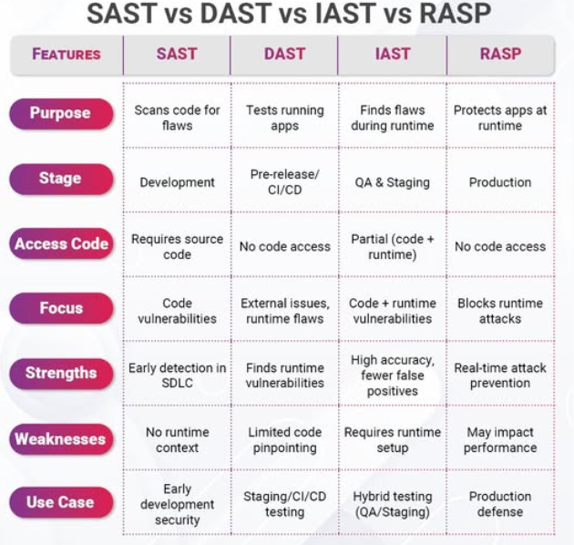

Slide 55
Where Each Fits in Secure SDLC
Design: Threat modeling (STRIDE)
Develop: SAST
Test: DAST, IAST
Deploy: Baseline scans
Operate: RASP & monitoring

Slide 56
Key Takeaways
Threat modeling prevents design flaws
STRIDE is simple and effective
No single testing tool is enough
Layered testing reduces risk
DevSecOps needs all approaches

Slide 57
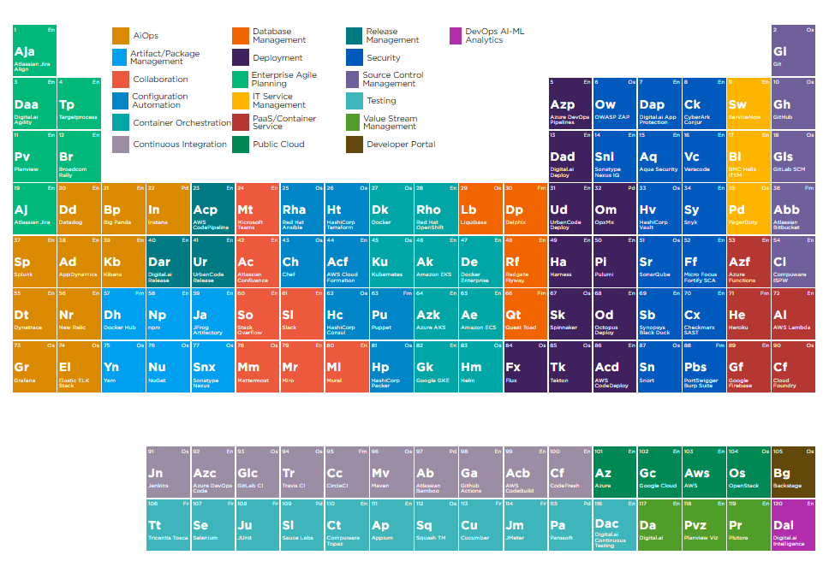
DevSecOps Tools Chain

Slide 58
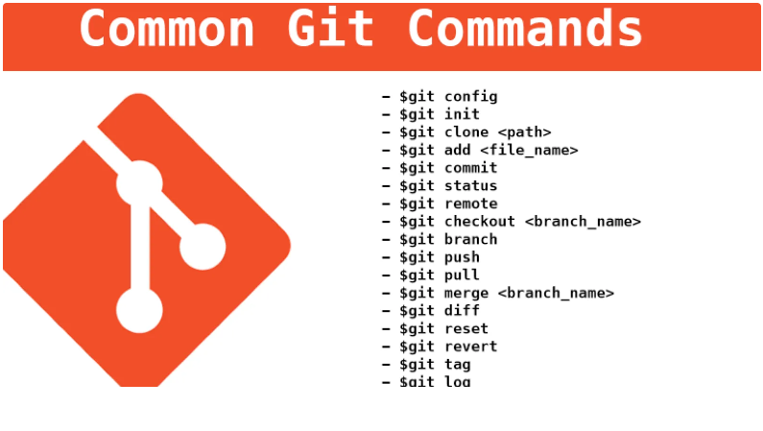
Git

Slide 59
What is OWASP?
Global non-profit focused on application security
Provides open standards, tools, and guidance
Community-driven and vendor-neutral
OWASP Top 10 highlights critical app risks
Based on real-world vulnerabilities and breaches
Recognised by enterprises, auditors, and regulators

Slide 60
Why OWASP Top 10 Matters
Covers majority of common application security issues
Used as baseline security standard
Helps prioritise security investments
Creates shared language across teams
Maps directly to Secure SDLC and DevSecOps
Relevant for audits and compliance

Slide 61
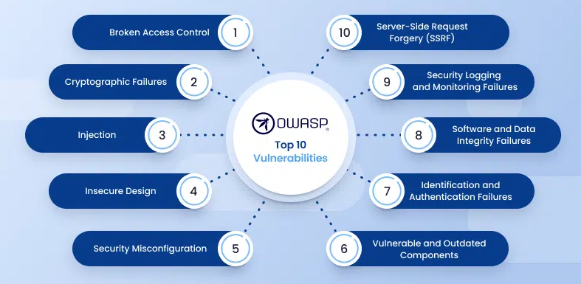

Slide 62
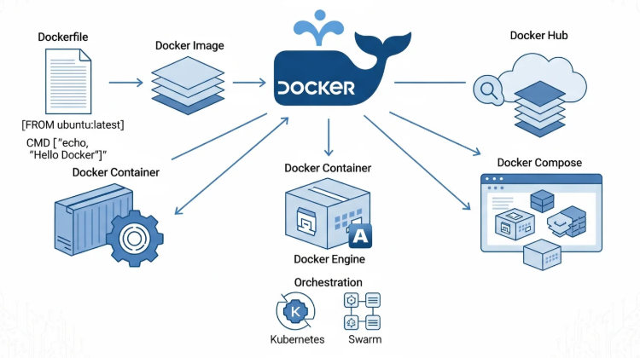
Docker

Slide 63
Juice Shop setup
Setup sample vulnerable application
docker run -d --name juice-shop -p 3000:3000 bkimminich/juice-shop
http://localhost:3000

Slide 64
A01: Broken Access Control
What: Users access data or actions beyond permissions
Why: Missing server-side checks, trusting client logic
Impact: Data exposure, fraud, account takeover
Banking: Viewing other accounts, unauthorised transfers
Attack: IDOR, forced browsing, privilege escalation
DevSecOps: Centralised authZ, automated access tests

Slide 65
A01: Broken Access Control
Exercise
A01_Broken_Access_Control_Multiple_Scenarios_JuiceShop

Slide 66
A02: Cryptographic Failures
What: Sensitive data not properly encrypted
Why: Weak algorithms, no TLS, poor key management
Impact: PII leakage, data breaches
Banking: Exposure of customer and transaction data
Attack: Sniffing, weak cipher exploitation
DevSecOps: TLS everywhere, secrets & key management

Slide 67
A02: Cryptographic Failures
exercise A02_Cryptographic_Failures_JuiceShop_Exercise

Slide 68
A03: Injection
What: Untrusted input executed as code or queries
Why: No input validation, dynamic query building
Impact: Data theft, system compromise
Banking: Transaction manipulation, data leakage
Attack: SQL, NoSQL, command injection
DevSecOps: Parameterised queries, SAST

Slide 69
A04: Insecure Design
What: Security flaws in application design
Why: No threat modelling, business logic gaps
Impact: Workflow abuse, fraud
Banking: Approval bypass, logic manipulation
Attack: Abuse of intended functionality
DevSecOps: Threat modelling, design reviews

Slide 70
Challenge
Missing Business Logic Controls
Scenario
The application allows users to add unlimited items to the shopping basket.
Challenge
Login as a normal user
Add the same product repeatedly to the basket
Try to exceed reasonable limits (e.g., 100+ items)

Slide 71
Challenge
Weak Password Policy by Design
Scenario
The application allows extremely weak passwords.
Challenge (Student Task)
Register a new user
Use a password like:
123
password
a

Slide 72
A05: Security Misconfiguration
What: Insecure or incorrect system settings
Why: Defaults, open ports, debug enabled
Impact: System compromise, data exposure
Banking: Exposed admin consoles, storage
Attack: Default creds, open services
DevSecOps: IaC, secure defaults, scanning

Slide 73
A06: Vulnerable & Outdated Components
What: Libraries with known vulnerabilities
Why: No dependency visibility or scanning
Impact: Remote code execution
Banking: Third-party risk exposure
Attack: Public exploits against known CVEs
DevSecOps: SCA tools, automated updates

Slide 74
A07: Identification & Authentication Failures
What: Weak authentication and sessions
Why: Weak passwords, poor session handling
Impact: Account takeover
Banking: Fraudulent transactions
Attack: Credential stuffing, session hijacking
DevSecOps: MFA, secure session management

Slide 75
A08: Software & Data Integrity Failures
What: Code or data integrity not verified
Why: Unsigned artifacts, insecure pipelines
Impact: Supply chain attacks
Banking: Compromised deployments
Attack: Artifact or update tampering
DevSecOps: Signed artifacts, pipeline security

Slide 76
A09: Logging & Monitoring Failures
What: Security events not logged or monitored
Why: Poor logging strategy, no alerts
Impact: Delayed breach detection
Banking: Compliance and audit failures
Attack: Long undetected abuse
DevSecOps: Central logging, SIEM integration

Slide 77
A10: Server-Side Request Forgery (SSRF)
What: Server makes unintended requests
Why: Unvalidated user-controlled URLs
Impact: Internal service compromise
Banking: Cloud metadata access
Attack: Internal scanning, credential theft
DevSecOps: URL allowlists, network segmentation

Slide 78
What is Application-Level Security?
Security implemented within application code
Protects business logic and data
Beyond infrastructure and network security
Primary responsibility of developers
Directly impacts users and customers

Slide 79
Why Application Security Matters
Most breaches exploit application flaws
APIs and web apps are primary attack surface
Business logic abuse causes fraud
Impacts customer trust
Critical in banking systems

Slide 80
Common Application Security Risks
Broken access control
Injection vulnerabilities
Authentication flaws
Insecure session management
Sensitive data exposure

Slide 81
Key Secure Coding Practices
Validate all user input
Enforce authorization on server side
Use secure authentication mechanisms
Handle errors safely
Never trust client-side logic

Slide 82
Application Security & OWASP
OWASP Top 10 maps common risks
Guides secure coding decisions
Helps prioritise fixes
Forms baseline AppSec knowledge
Used widely in industry

Slide 83
Application Security in Secure SDLC
Security requirements early
Threat modeling during design
Secure coding in development
Automated testing
Continuous improvement

Slide 84
Key Takeaways
Application security is foundational
Developers play a key role
Most issues are preventable
Early fixes are cheaper
DevSecOps enables secure delivery

Slide 85
OWASP ZAP Baseline Scan (DevSecOps)
What is ZAP Baseline Scan?
OWASP ZAP is an open-source DAST tool
Baseline Scan is passive and safe for CI/CD
Detects common security issues without attacking the app
Ideal for early security checks in DevSecOps pipelines
Why Use It?
Fast, safe, and automation-friendly
No authentication required
Works well in DEV/TEST environments

Slide 86
ZAP Baseline Scan in CI/CD
How It Works
Crawls the application URL
Passively analyses HTTP traffic
Generates HTML/JSON/XML reports
What It Detects
Missing security headers
Cookie security issues

Slide 87
ZAP Baseline Scan in CI/CD
What It Detects
Information disclosure
CORS & HTTP method issues
Limitation
Does NOT exploit vulnerabilities
Use ZAP Full Scan for deeper testing

Slide 88
ZAP
Exercise
OWASP_ZAP_Baseline_Ubuntu_HandsOn

Slide 89
GitHub
Create account

Slide 90
Why Git Security Matters
Git history is permanent
Secrets committed once are exposed forever
Public repositories amplify risk
Insider mistakes are common
Breaches often start with leaked secrets

Slide 91
What Are Secrets?
Passwords
API keys
Tokens
Certificates
Database credentials
Cloud access keys

Slide 92
Common Ways Secrets Leak
Hardcoded in source code
Configuration files
Environment files committed
Debug logs
Copy-paste from local tests

Slide 93
Real-World Impact of Secret Leaks
Full system compromise
Cloud resource abuse
Financial loss
Data breaches
Regulatory violations

Slide 94
Git Security in Secure SDLC
Secrets never in code
Use environment variables
Centralised secret stores
Automated scanning
Fail fast in pipelines

Slide 95
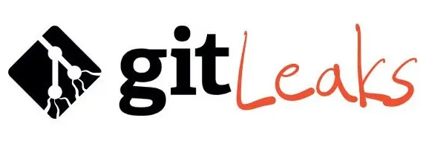
What is Gitleaks?
Open-source secret scanning tool
Scans Git repos and history
Detects many secret patterns
Fast and developer-friendly
CI/CD ready

Slide 96
How Gitleaks Works
Pattern-based detection
Entropy checks
Scans commits, branches, history
Pre-commit and CI modes
Configurable rules

Slide 97
Gitleaks in Developer Workflow
Pre-commit hooks
Local scans before push
Fast feedback
Developer ownership
Reduced production risk

Slide 98
Gitleaks in CI/CD Pipelines
Automated secret scanning
Fail builds on detection
Prevent risky merges
Generate audit evidence
Support compliance

Slide 99
Hands-on Exercise (In Class)
Clone sample vulnerable repo
Run Gitleaks scan
Identify leaked secrets
Remove secrets correctly
Re-run scan to verify

Slide 100
Best Practices for Secret Management
Never hardcode secrets
Rotate exposed credentials
Use vaults (Azure Key Vault, AWS Secrets Manager)
Restrict access using least privilege
Monitor and audit secret usage

Slide 101
Key Takeaways
Git security is foundational
Humans make mistakes – automation helps
Gitleaks prevents accidental leaks
Secret management is DevSecOps responsibility
Early detection reduces blast radius

Slide 102
Secrets Exposure: The DevSecOps Problem
Developers accidentally commit secrets (API keys, tokens, passwords)
Secrets spread via Git history, forks, and PRs
Leads to breaches, cloud compromise, and compliance issues
Key Message:
Secrets leakage is one of the most common DevSecOps failures.

Slide 103
GitGuardian & ggshield Overview
GitGuardian:
Enterprise secrets detection & prevention platform
Detects 350+ types of secrets
ggshield:
Official GitGuardian CLI tool
Used on developer machines and CI/CD pipelines
One-liner:
GitGuardian is the platform. ggshield is its CLI.

Slide 104
Where ggshield Fits in DevSecOps
Developer Laptop:
Pre-commit secret detection (shift-left)
CI/CD Pipeline:
Scan repos during build, fail on leaks
Repository Monitoring:
Continuous scanning & alerts
Approach:
Prevention → Detection → Alerting → Remediation

Slide 105
GitGuardian vs Gitleaks
ggshield (GitGuardian):
SaaS-backed, dashboards, alerts
Incident workflows & governance
Gitleaks:
Open-source, offline scanning
Ideal for lightweight pipelines
Key Takeaway:
They complement each other, not replace.

Slide 106
Pre read https://github.com/arjunachari12/devsecops-training/blob/main/DevSecOps_PreRead_Day2-4.md

Slide 107
GitGuardian
Exercise
GitGuardian_ggshield_HandsOn_Guide

